Slide 1
Are Texas Kids Prepared to Win the Future? Release of the 2011 National KIDS COUNT Data Book
Frances Deviney, Ph.D.
Texas Kids Count Director
Center for Public Policy Priorities
August 17, 2011

Slide 2
Notes:
This year’s data book examines how children and families are faring in the wake of the recession and proposes a 1-2 punch solution: strengthening families in order to support children now and in the future.

Slide 3
http://datacenter.kidscount.org
Notes:
The data we are sharing today can be found at http://datacenter.kidscount.org

Slide 4
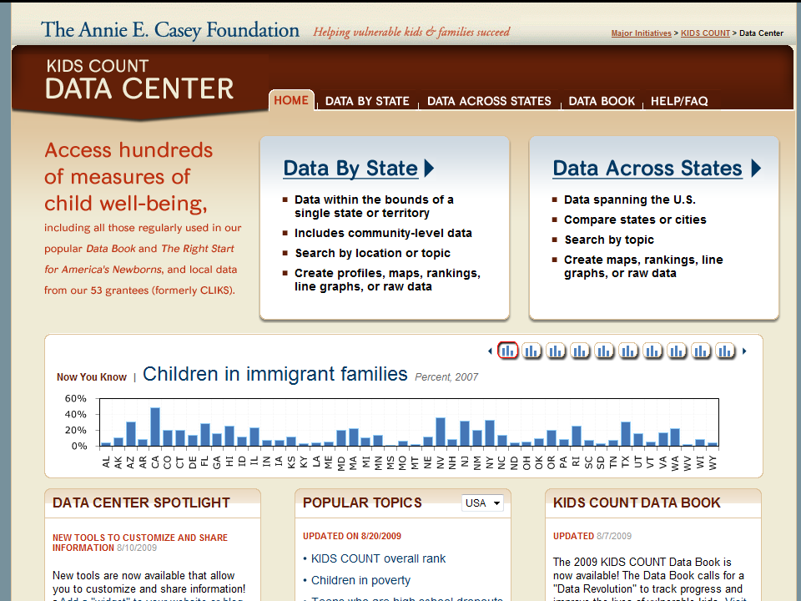
4
Notes:
Data found in Data Across States is maintained by the Annie E. Casey Foundation with help from Child Trends and the Population Reference Bureau. Data comes from the U.S. Census and Federal agencies. Data you find here is the most recent data available on child wellbeing. Data in this section can be compared across states and cities since the methodology used to collect the data is consistent. You will be able to perform the same functions as those shown above only for indicators available at the state and city-level. Let’s click on Data Across States.
One-stop shop for city, county, state, and national information on children and families
Rank states, cities and counties
Generate customized maps, graphs and trend lines
Feature automatically updated maps and graphs on your own website or blog
http://datacenter.kidscount.org
4

Slide 5
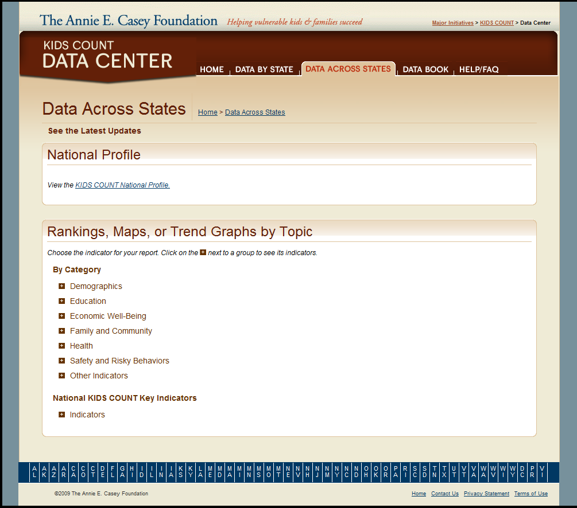
5
Notes:
You will be taken to a page that looks like this. Here you will be able to access the National Profile, which will show you KIDS COUNT’s ten key indicators used to rank states on how they are doing when it comes to their children’s well-being. You will also be provided with the option of customizing your profile, here you will be able to pick and choose which indicators you want included in your National Profile.
The state rankings can be found under “Other Indicators”.
5

Slide 6
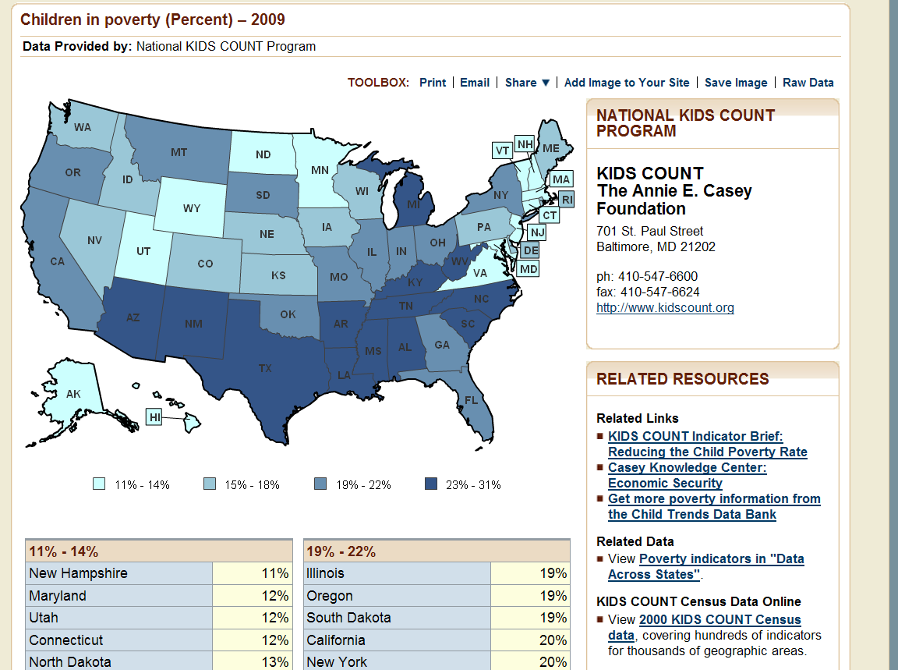
6
Notes:
Here is what the map looks like for data under Data Across States. As mentioned previously, the same functions are available for maps in this section.
Additional resources and information related to this topic can be found under Related Resources.
Definitions, sources and notes can be found at the bottom of the page.
6

Slide 7
Notes:
By clicking on Share you will be provided with the option of sharing your map or line graph through Facebook, Twitter and other social networking sites.

Slide 8
m.datacenter.kidscount.org
Notes:
The Annie E. Casey Foundation has also just updated their mobile data site. The interface is beautiful and much easier to use. And it now gives you access to all of the data that the Texas KIDS COUNT project posts for each of our 254 counties.

Slide 9
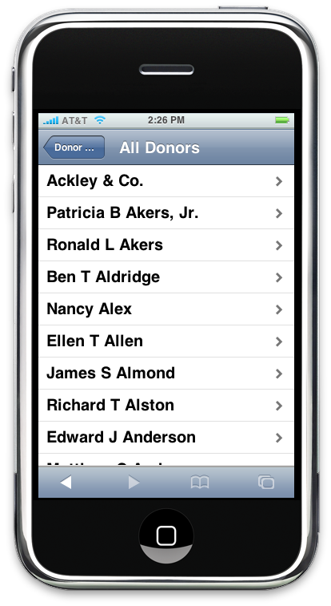
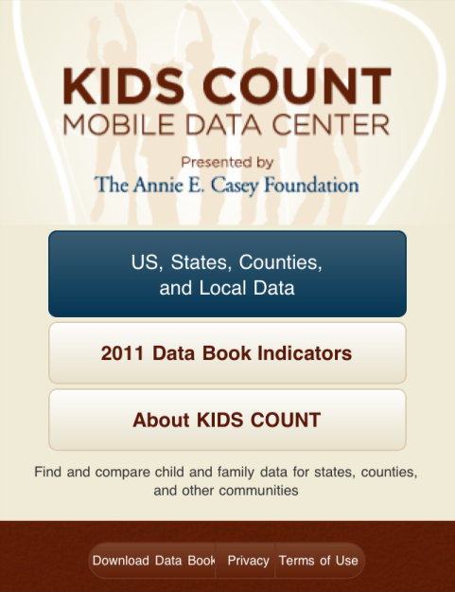

Slide 10
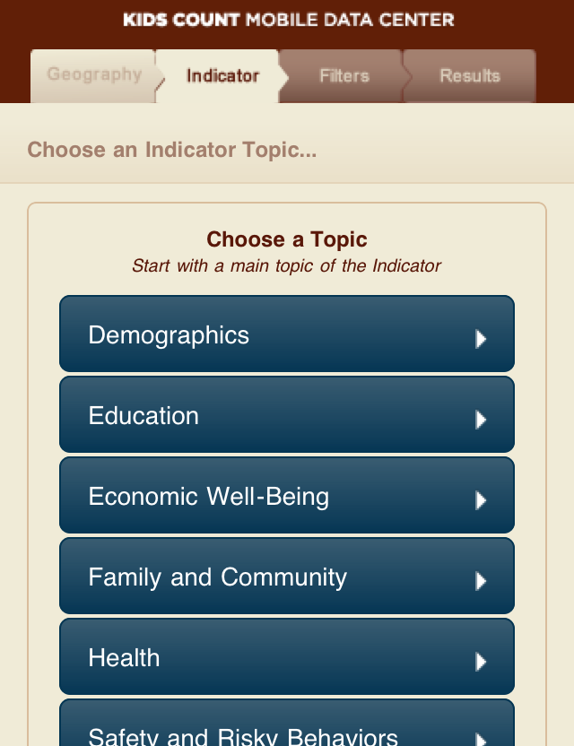

Slide 11
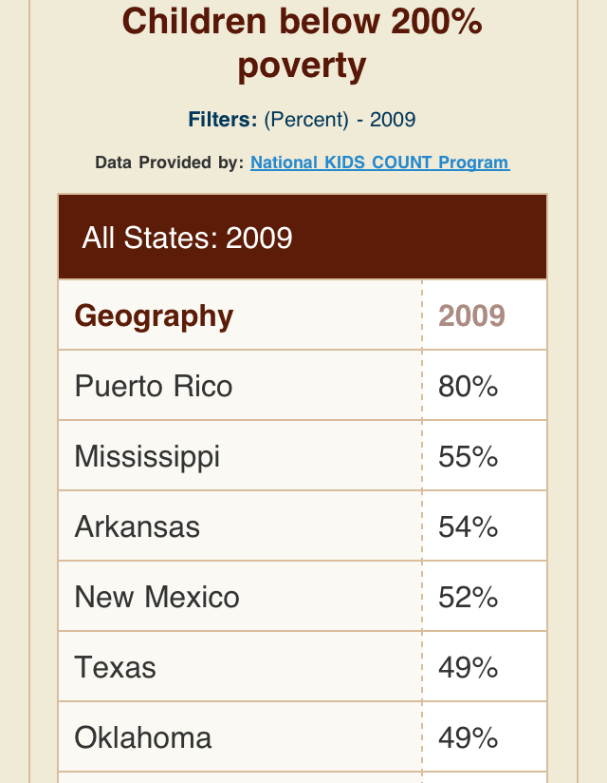

Slide 12
Notes:
This year’s data book examines how children and families are faring in the wake of the recession and proposes a 1-2 punch solution: strengthening families in order to support children now and create opportunities for the future.

Slide 13
Notes:
So the question is, are Texas’ kids prepared to win the future? Let’s see how they’re doing.

Slide 14
After significant declines in the 1990s, the 2000s see increases in child poverty rate
Recession began in 2008
Source: Small Area Income and Poverty Estimates, U.S. Census Bureau
Notes:
Child poverty
US: 2009 = 14.6M, grew by 2.45M since 2000
TX: 2009 = 1.66M, grew by 407,000 since 2000

Slide 15
To be considered “officially poor,” a family of three has to make less than
18,530 / year
Source: 2011 Poverty Guidelines for a family of 3 with two related children under 18 years old
Notes:
Guidelines from -- http://aspe.hhs.gov/poverty/11poverty.shtml
Family of 3 = $18,530
Family of 4 = 22,350
Thresholds from: http://www.census.gov/hhes/www/poverty/data/threshld/index.html

Slide 16
U.S. added 2.5M poor kids since 2000; Of those, 1 of every 6 live in Texas
Source: KIDS COUNT Data Center, Annie E. Casey Foundation
Notes:
Child poverty
US: 2009 = 14.6M, grew by 2.45M since 2000
TX: 2009 = 1.66M, grew by 407,000 since 2000

Slide 17
When a household falls into poverty, children are exposed to increased parental distress, inadequate childcare, poor nutrition, and negative health outcomes.
Notes:
Children who grow up in low-income families are less likely to successfully navigate life’s challenges and achieve future success

Slide 18
What is happening with the economy?

Slide 19
Senate OKs teacher furloughs, pay cuts
We have a budget, but not a prayer
Notes:
We’re receiving very mixed stories about what’s going on.

Slide 20
TX Unemployment hit peak in June 2011
Current poverty data from this time period
Source: Monthly Unemployment Rate (%), Not Seasonally Adjusted; Texas Workforce Commission
Notes:
20
20
Because poverty tracks unemployment, we expect that poverty will increase when new numbers come in.
TX June 2008: 4.8%
TX June 2011: 8.8% (83% increase)
May see these numbers continue to climb due to slowing economic recovery and impact of state budget cuts. 5,000 state government jobs were cut out of state budget. If schools close funding gaps with staffing cuts, may see up to 49K additional jobs lost at local schools. Given multiplier effect (1.5), that could lead to an additional 69K private sector jobs.

Slide 21
TX Children with at least one unemployed parent
607,000
303,000
9%
5%
2007
2010
Source: Current Population Survey, Kids Count Data Center
Notes:
US = 7,757,000 (11%)

Slide 22
Texas added nearly 281,000 jobs from 2007-2010
Source: CPPP analysis of 1st quarter 2007 and 4th quarter 2010 labor market data, TWC
Notes:
Of 281,000 jobs added in TX, 53% were private sector, 47% were public sector (govt)
Of 311,042 government jobs added in US, TX add 132,216 jobs or 42% of all government jobs in US
Private sector is 6 times the size of the govt sector jobs. Public sector jobs grew at 4 times the rate (7.7%) of private sector jobs (1.8%). In order for us to bring unemployment down to prerecession levels, have to add 32,000 jobs per month for 3 years straight (CBPP analysis).

Slide 23
Texas’ working-age adult population grew at twice the rate of U.S.
Source: Adults 25-64, U.S. Decennial Census Data, 2000 and 2010
Notes:
Working age = 25 to 64 years
From 2000 to 2010, Texas increased by 22.5% from 10,693,648 to 13, 104, 882 while the U.S. increased by only 11.3% from 146,992,887 to 163,631,112
Leads to growth in service jobs:
Education and health grew by 16.7%
Natural resources and mining grew by 7.7%
Local gov’t jobs grew by 8.1%

Slide 24
Texas’ child population added nearly ONE MILLION Kids
2000 (5.9M)
2010
6.9 M
Source: 2000 and 2010 Decennial Census data, U.S. Census Bureau
Notes:
Based on 2008 data from the CDC, Texas has the 2nd highest birth rate (16.7 babies born per 1,000 people), tied with Alaska and only behind Utah. The U.S. birth rate is 14.0. That puts our rate 19.3% higher than the U.S. average.
Between 2000-2010, the U.S. total population grew by 9.7% from 281,421,906 to 308,745,538 people. Texas’ total population grew by 20.6% from 20,851,820 to 25,145,561. That makes our growth rate 112% higher than the national average.
Important Notes
According to a recent presentation from the State Demographer’s office, 53.7% of Texas’ growth was due to natural increase (more births than deaths). In fact, Texas’s child pop growth accounts for ½ of all the child population growth in the U.S. from 2000-2010.
The remaining 46.3% increase in the total population was due to migration (both international and intrastate). The Census Bureau has not released the data for them to break this out by international vs. intrastate migration yet. That should arrive in the next few months.
Although we added the most people of any state, we didn’t have the largest growth rate. That title went to Nevada at 35%. AZ, UT, and ID were also higher than TX.

Slide 25
Texas has highest percentage of low-wage jobs in country
Source: 2010 wage and salary workers, Bureau of Labor Statistics
Notes:
Although we have added many jobs, recent data suggests that many of the jobs we have in Texas may not be the kinds of jobs that can support families.
Largest # too: 550,000. Next closest is NY 264,000.
Minimum wage has been $7.25 per hour since 2009, with no plan to raise it any time soon. That means that if both parents worked full time, they would make just over $30,000 a year combined, before taxes. If they had two kids, that income would be too low to meet basic needs, leaving them to dependent upon public health insurance and free school lunch for their children, and Food Stamps for the entire family.

Slide 26
53% Low-income VS. 6% Higher income
Homeowners spending > 30% of income on housing
Source: CPPP analysis of 2009 ACS data
Notes:
Housing not all that affordable for low-income Texans
Table 25095, 2009 1-year ACS data
Low income = <$35,000 household income
Higher income = >$75K household income
In a recent article in the Austin American Statesman, researchers Taylor and Gregory justified Texas’ low-wages by saying that our workers are willing to accept them because the cost of living (housing and taxes) is comparatively low. The question is not whether Texas has low-cost housing compared to the U.S. The question is whether Texas’ low-wage workers have access to affordable housing. The answer is no.
According to the Census Bureau, over half of Texas’ low-income homeowners and nearly three of every four low-income renters spend more than 30 percent of their income on housing, a common assessment of affordability. By comparison, only one in 17 homeowners and one in 22 renters in higher income households spend more than 30 percent on housing. [Add chart? AAS did that w/ original article]

Slide 27
71% Low-income VS. 2% Higher income
Renters spending > 30% of income on housing
Source: CPPP analysis of 2009 ACS data

Slide 28
TX children affected by foreclosure since 2007
281,000
3%
Source: Kids Count Data Center
Notes:
US = 5,288,000 (4%)
Savings and home ownership related to improved cognitive development among school-age children and graduation rates. Loss of home can disrupt education and place significant emotional stress on the family.
Foreclosure also widened an already enormous racial and ethnic gap in homeownership. Nationally, foreclosure rate for Black and Latino families was roughly 170% that of Whites and Asian Americans.
Data Source: Population Reference Bureau analysis of 2007-2009 data from the Mortgage Bankers Association’s (MBA) National Delinquency Survey (NDS) and the U.S. Census Bureau’s 2007, 2008, and 2009 American Community Survey Public Use Microdata Sample (PUMS). The National Delinquency Survey (NDS) is conducted quarterly by the Mortgage Bankers Association and is a sample of approximately 44 million mortgage loans serviced by various agencies. NDS provides quarterly delinquency and foreclosure statistics at the national, regional and state levels. The American Community Survey (ACS) is a continuous demographic survey conducted by the Census Bureau, sent to approximately 250,000 addresses monthly, and replaces the long form decennial census. The Census Bureau produces 1-, 3- and 5-year Public Use Microdata Sample (PUMS) files. The 2009 ACS PUMS represents a sample of the data collected throughout the 2009 calendar year.

Slide 29
How does this ongoing economic stress affect our kids?
Notes:
Two decades of research show that ongoing exposure to economic stress and hardship harms children primarily through two mechanisms:
Decreased parental investments in children
Basic needs: food, child care, health care, safe housing
Enrichment: books, toys, activities to enrich
High levels of parental stress
Leading to depression & anxiety
Risk of substance abuse and violence
All compromising successful parenting

Slide 30
What’s happening?

Slide 31
We have a work-support system that doesn’t support work.

Slide 32
Unemployment Insurance Inadequate
Notes:
Our unemployment insurance, as currently designed, cuts off for many families who are experiencing extended unemployment due to the extended downturn in the economy. Also, because of our outdated method of determining eligibility for UI, many hard working Texans have not been able to access UI or hasn’t had all of their wages considered when determining UI support.

Slide 33
Texas Has Highest Rate of Uninsured Children in the Nation Eleven Years Running
Source: Kids 0-18, KIDS COUNT State-Level Data Online, Annie E. Casey Foundation
Notes:
Another work support is insurance coverage for children and their parents.
TX has highest # (1,378,000) and %
And no child in Texas should go without health care. Yet 1 in 5 Texas kids don’t have health insurance, making it difficult to get the preventive care, vaccinations, and dental care that growing children need.
Children without regular health care are more likely to contract illnesses, poorer oral health, and vision and hearing. Increased incidence of asthma.
And with the 3rd worst teen birth rate (50% higher than national average), and an increasing LBW and IMR, we are in desperate need to get more moms and babies effective coverage so they can see a doctor before problems start.
http://www.census.gov/hhes/www/cpstc/cps_table_creator.html
Nat’l KC Data Center analysis of 3-year average data from CPS March Supplement (health insurance at any point during the year).
Bexar rank in 2005 = 204th!!! w/ 97,868 (22.3%) uninsured; 2010 projections = 112,269 (23.3%)
Further complicating children’s educational outcomes, low-income children are less likely to have access to health care services due to lack of health insurance or a lack of access to doctors.
TX = 1.4M
1/2 of uninsured children are eligible for Medicaid or CHIP. 1/3 middle income families.
1.44 million uninsured

Slide 34
Texas Ties for Worst Rate of Child Food Insecurity
1.6 Million (24%)
Hungry children:
Miss more school
Less attentive
More likely to fail and be held back
More likely to drop out
Source: 2006-2008 Current Population Survey, Kids Count Data Center
Notes:
Another work support is making sure families are able to feed their kids during times of economic hardship.
No child in Texas should ever feel the pangs of hunger. Yet today, Texas ranks 2nd worst in food insecurity. That’s 1.6 million Texas kids whose families report that they don’t know where their next meal is coming from.
It’s just not right that a child can go hungry because her parent lost a job, through no fault of her own.
Definitions: Children living in households, where in the previous 12 months, there was an uncertainty of having, or an inability to acquire, enough food for all household members because of insufficient money or other resources. For more information on the definition of Food Security/Insecurity see: http://www.ers.usda.gov/Briefing/FoodSecurity/measurement.htm More...
Data Source: Population Reference Bureau, analysis of data from the U.S. Census Bureau, Current Population Survey, Food Security Supplement.
Footnotes: Updated May 2010. N.A. – Data not available.

Slide 35
Texas is 5th lowest in per pupil expenditures in 2011
Underfunded public education by $4 Billion for 2012-13
Notes:
Education is also a critical work support not only for families now, but for building a strong workforce for the future.
Per pupil expenditure data from Kids Count Data Center.
2011, TX spends $8,439 per student, ahead only of AZ, NC, NV, & UT (lowest at $6,525). WY & VT spend $17K+/student

Slide 36
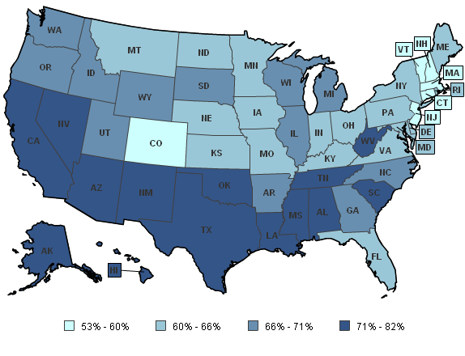
Texas is in the bottom quarter of states for reading proficiency
TX 72%
Source: Annie E. Casey Foundation, National KIDS COUNT Report
Notes:
How do we compare to the rest of the country?
Texas is in the bottom quarter of states for reading proficiency (37th). 72% of Texas 4th graders aren’t reading proficiently
This is an academic tipping point where children stop learning to read and begin reading to learn. IF they haven’t mastered the skills by this point, they will fall farther and farther behind their peers in both reading AND all other subjects where reading is required for subject matter comprehension.
Texas’ economy demands a more educated workforce, and reading proficiency is the key.
72% of Texas kids scored below proficient reading level in 2009 vs 68% in the US.
Texas ranked 37th in reading proficiency
Nearly ¾ of Texas 4th graders are not considered proficient in reading (68% across the US)
Texas is in the bottom quarter of states for student reading proficiency
83% of Texas kids on free or reduced-price lunch are not proficient vs. 57% of kids not on free or reduced-price lunch
Do we want to talk about the correlation between state per-pupil spending and reading proficiency?

Slide 37
Texas has a regressive tax policy Households With the Lowest Income Pay the Highest Percentage in State and Local Taxes
Source: Percentage of Household Income Paid in Taxes by quintiles, Tax Incidence Report, State Comptroller, 2011 http://www.window.state.tx.us/taxinfo/incidence/
Notes:
Texas ranks 5th nationally in terms of the effective tax rate is levies on the poorest 20% of its residents. Put another way, only four states require the poorest 20% of their residents to pay more of their incomes in state and local taxes.

Slide 38
What can we do?
Notes:
When a household falls into poverty, children are exposed to increased parental distress, inadequate childcare arrangements, and poor nutrition. (from SOTC 2011)

Slide 39
Children succeed . . .
when parents succeed.

Slide 40
Invest in a two-generation strategy

Slide 41
Help parents put their families on a path to economic success
Notes:
Help families make ends meet by preserving and strengthening existing programs that supplement poverty wages, offset the high cost of child care, and provide health insurance coverage for parents and children
Increasing income can positively affect child development, especially for younger children
Programs that increase family income through employment and training lead to improvements in school achievement and reductions in behavioral problems
Assets help families weather economic hardships and reduce stress that may impact parenting; allow for investment in education, create aspirations for children (expectations quote)

Slide 42
Strengthen Families
Strengthen EITC & SNAP
Make health care affordable & accessible to all
Encourage savings (tax time savings tools)
Protect assets (payday lending regulation)
Notes:
Make health care affordable – high medical costs the leading cause of bankruptcy among middle-income families

Slide 43
Enable Children to Reach Their Full Potential

Slide 44
Enable Children to Reach Their Full Potential
Support responsible parenthood and ensure that mothers-to-be receive prenatal care
Ensure children are developmentally ready to succeed in school
Succeed throughout schooling by promoting reading proficiency by the end of third grade
Notes:
Promote responsible parenthood and ensure that mothers-to-be receive prenatal care
Promote healthy marriage
Prevent teen pregnancy
Expand access to prenatal care
Ensure children are developmentally ready to succeed in school
Provide parenting support
Preserve and expand access to ECE programs
Succeed throughout schooling by promoting reading proficiency by the end of third grade
Pre-K through 12 systems.
Chronic school absence
Fight summer learning loss via summer learning programs as allowable use of Title I funds

Slide 45
Notes:
But the real story is not the numbers, but the people behind the numbers.
Let’s meet Manuel Luna. He’s a husband and father four living with his family in San Antonio. The Annie E. Casey Foundation interviewed him following his experience being unemployed for almost five months after he lost his job in 2009—a time he calls “our depression.”

Slide 46
“It broke me down, emotionally and mentally, that I couldn’t provide for my family. We’d never been in a situation like this before.”
Notes:
Angry and despondent after losing his role as the family breadwinner, Manuel Luna attended anger management classes and family counseling. The family found resources and service providers through the Annie E. Casey Foundation’s Making Connections program and the Casey-supported Center for Working Families, which serves low-income families.

Slide 47
Notes:
He credits the help he received from several programs with pulling his family through. The Earned Income Tax Credit provided extra cash to help the family catch up on bills and pay off debts. Supplemental Nutrition Assistance Program benefits (formerly food stamps) and the San Antonio Food Bank not only helped feed his family, but also freed up money to buy other essentials, like school uniforms and shoes.

Slide 48
Notes:
The Energy Assistance Program helped pay for utilities, which allowed other money to pay such bills as the rent.
“Right now, we’re stable,” says Luna, 31, who has worked since September 2010 as a utility technician for the city’s public water system and, before that, in a restaurant warehouse. “But we really went through a hard time. The programs helped us.”

Slide 50
Notes:
After their financial and emotional health improved, Manuel and Hilda Laura Luna plunged into community activities. Manuel has served as a PTA president and coached his children’s sports teams. The couple has been involved in a neighborhood improvement group and the Volunteer Income Tax Assistance program.

Slide 51
“I’m working a good job. . . I’m spending more time with my kids. For all the little things that I have, I am happy.” Manuel Luna, 31, San Antonio

Slide 52
Notes:
We know what to do. We just have to have the will to do it. And shout loudly when we don’t see it being done.

Slide 53
Notes:
Texas’ children will have a bright future if we create the space for families to succeed. Children succeed when families succeed. If we keep that as our number one priority . . . we will build a BETTER Texas.

Slide 55
Contact Information
Frances Deviney, PhD
Texas KIDS COUNT Director
deviney@cppp.org
(512) 320-0222 ext. 106

Slide 56
Use of This Presentation
The Center for Public Policy Priorities encourages you to reproduce and distribute these slides, which were developed for use in making public presentations.
If you reproduce these slides, please give appropriate credit to CPPP.
The data presented here may become outdated.
For the most recent information or to sign up for
our free E-Mail Updates, visit www.cppp.org.
© CPPP
Center for Public Policy Priorities
900 Lydia Street
Austin, TX 78702
Phone 512-320-0222 Fax 512-320-0227

